Slide 1

SENG2260 Human-Computer Interaction
Workshop 10
Week 10
SPS

Slide 2
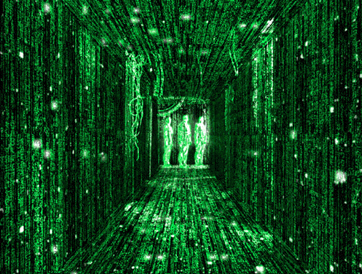
Notes:
The Matrix as the ultimate brain-computer interface and immersive user experience.

Slide 3
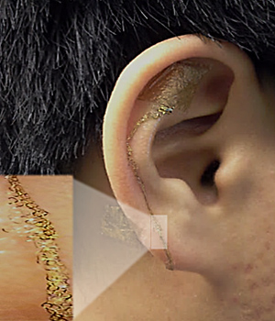
Today
BCI: Brain Computer Interaction
Brainwaves. Not Thoughts
Example COTS tech with the NeuroSky Mindwave interface
The NeuroSky platform provides a powerful foundation for developing applications that promote improved focus, concentration, working memory, and mind acuity
http://bit.ly/1EuzoYS
Photo: John Rogers/University of Illinois

Slide 4
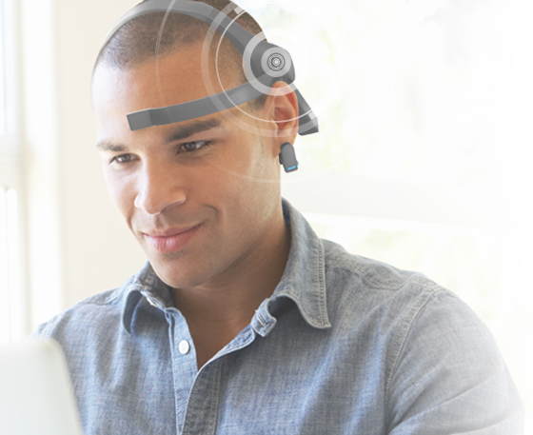
NeuroSky MindWave (http://neurosky.com)
NeuroSky’s EEG (Electroencephalogram) biosensor digitizes and amplifies raw analog brain signals
Video: https://vimeo.com/282886384#t=1m36s
EEG Biosensor
Direct connect to dry electrode
One EEG channel + Reference + Ground
Extremely low-level signal detection
Advanced filter with high noise immunity
RAW EEG at 512Hz
eSense Brainwave Patterns
RAW EEG Signal
Attention & meditation
Eye Blink
Delta, Theta, low alpha, high alpha, low beta, high beta and gamma waves
Photo: www.neurosky.com

Slide 5
Brain-Computer Interaction
How will BCI change the nature of HCI interaction
What are BCI issues?
Ethical issues?
Does BCI impact the Gulf of Execution?
Does BCI impact the Gulf of Evaluation?
How does BCI impact user interface design?
How does BCI impact evaluation?

Slide 6
Next workshop
Week 11 : Ethics and HCI
You will have reviewed the ACS Code of Ethics
https://www.acs.org.au/content/dam/acs/rules-and-regulations/Code-of-Ethics.pdf
You will have reviewed the IEEE Code of Ethics
https://www.ieee.org/about/corporate/governance/p7-8.html

